Slide 1



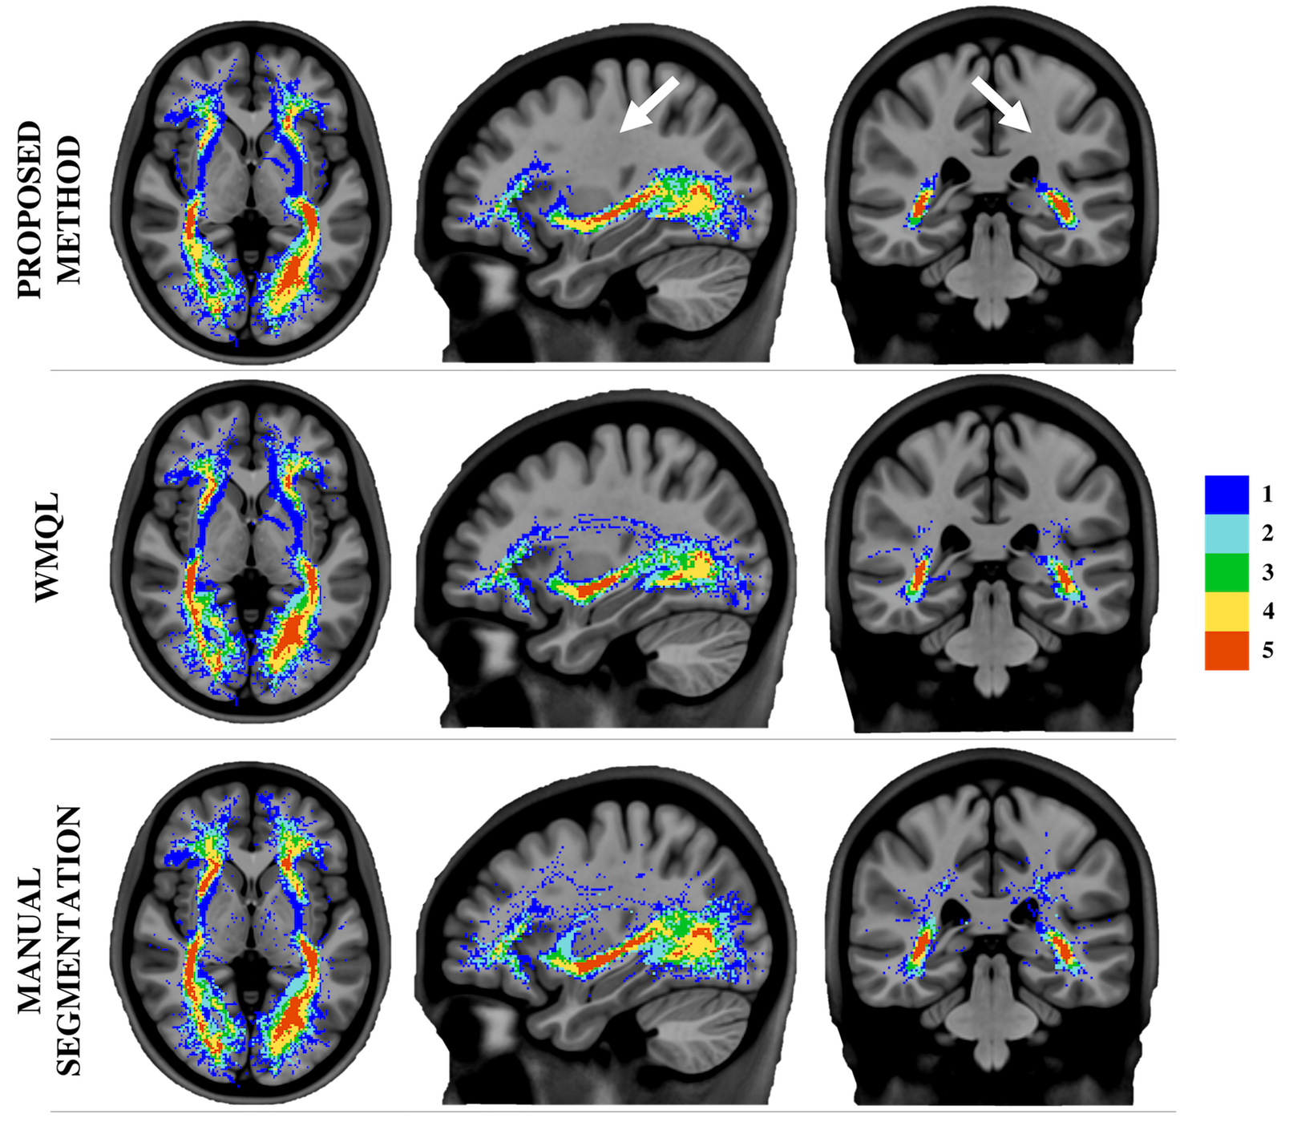
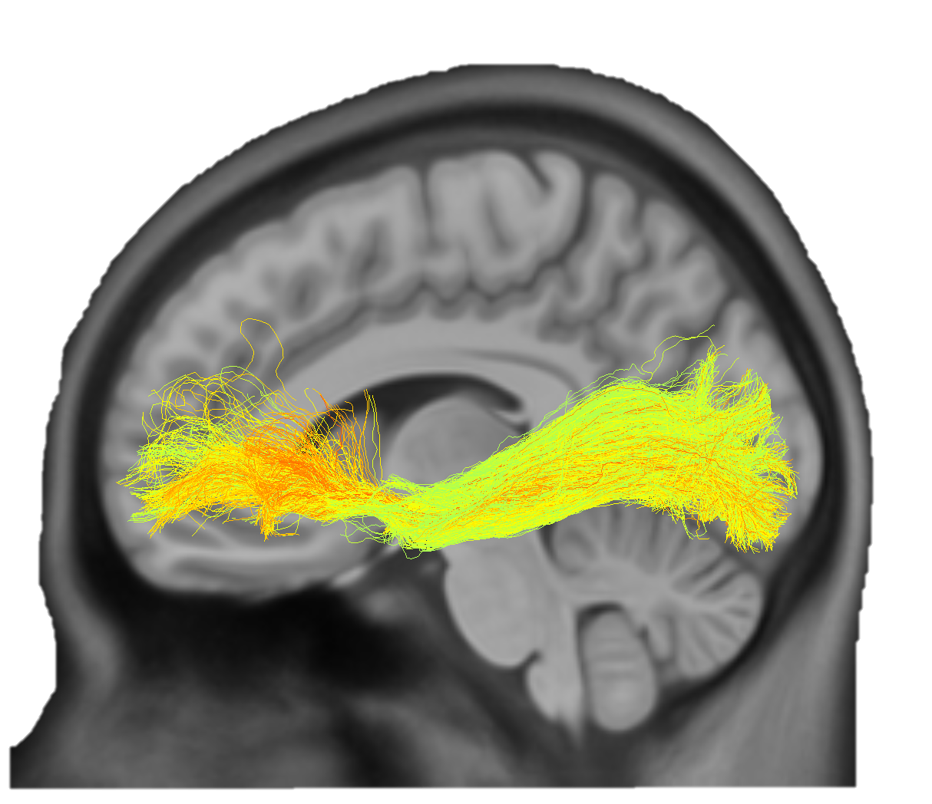
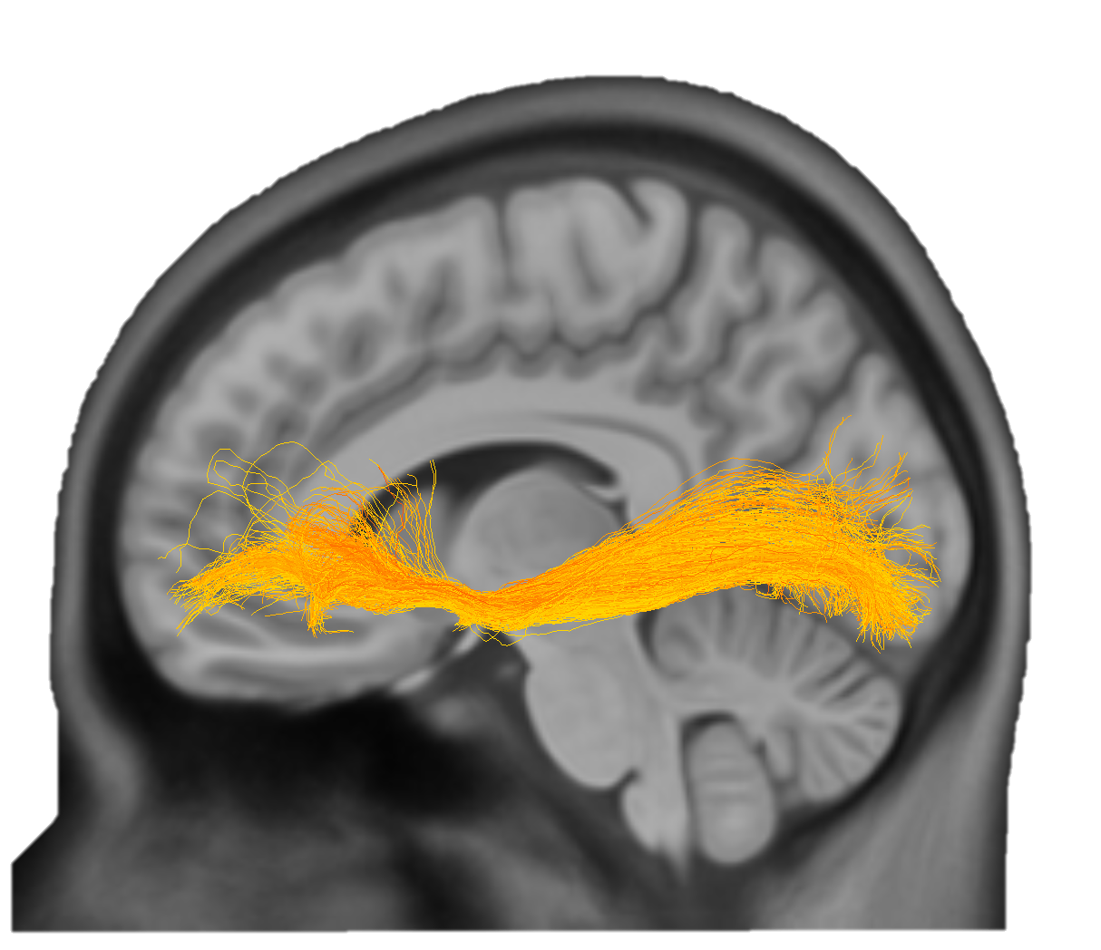
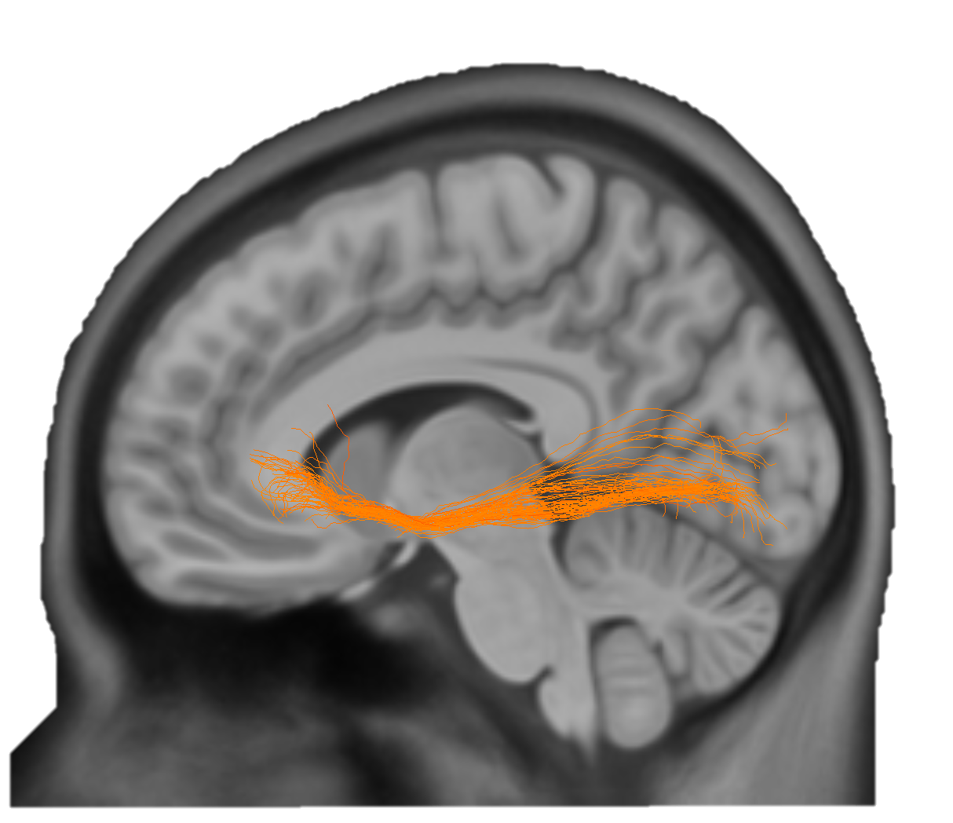
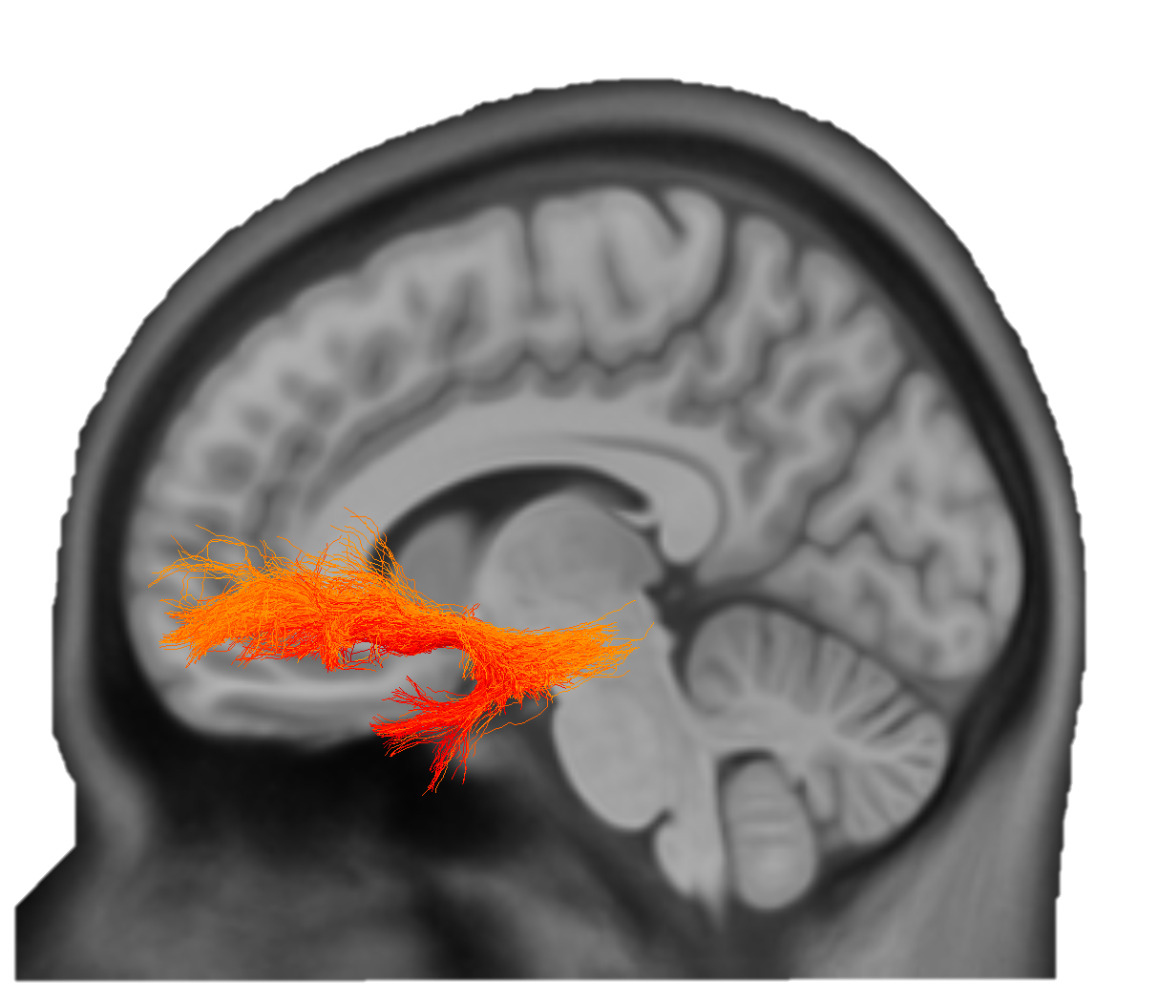
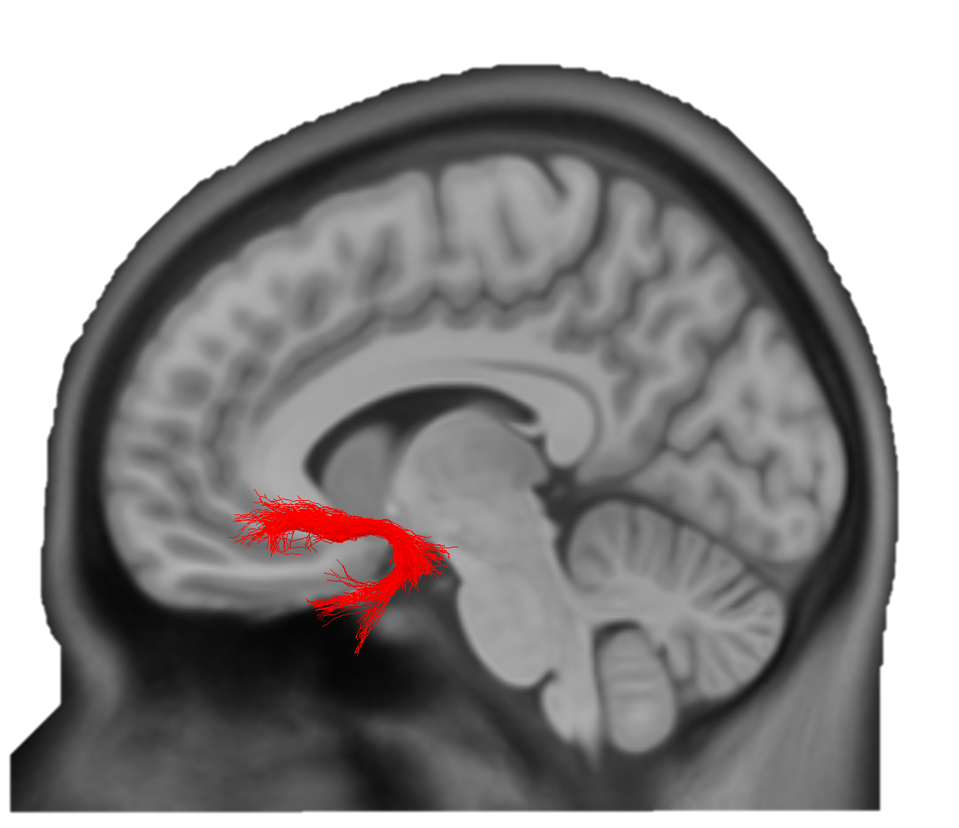

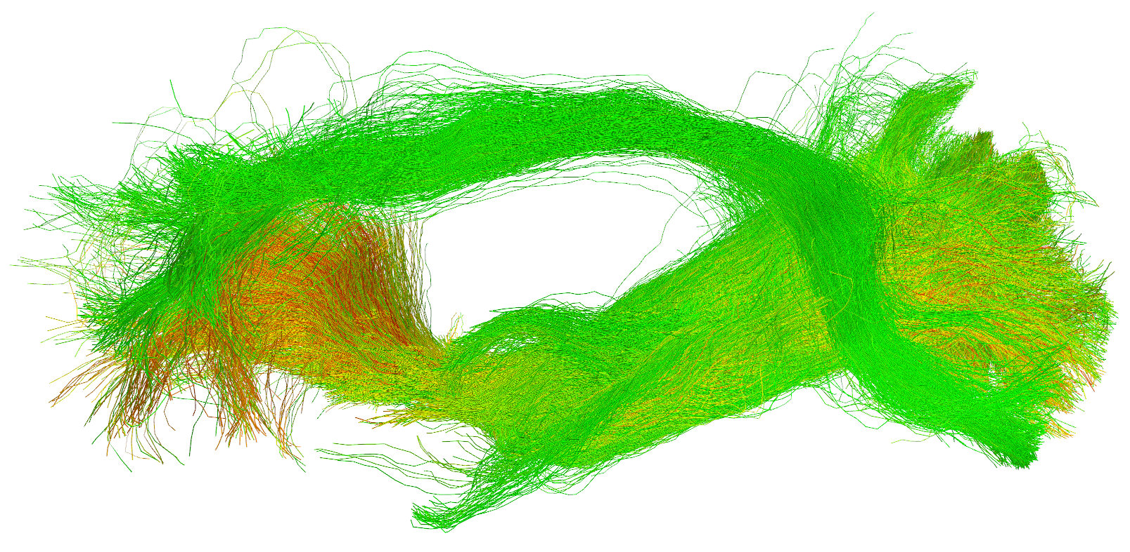
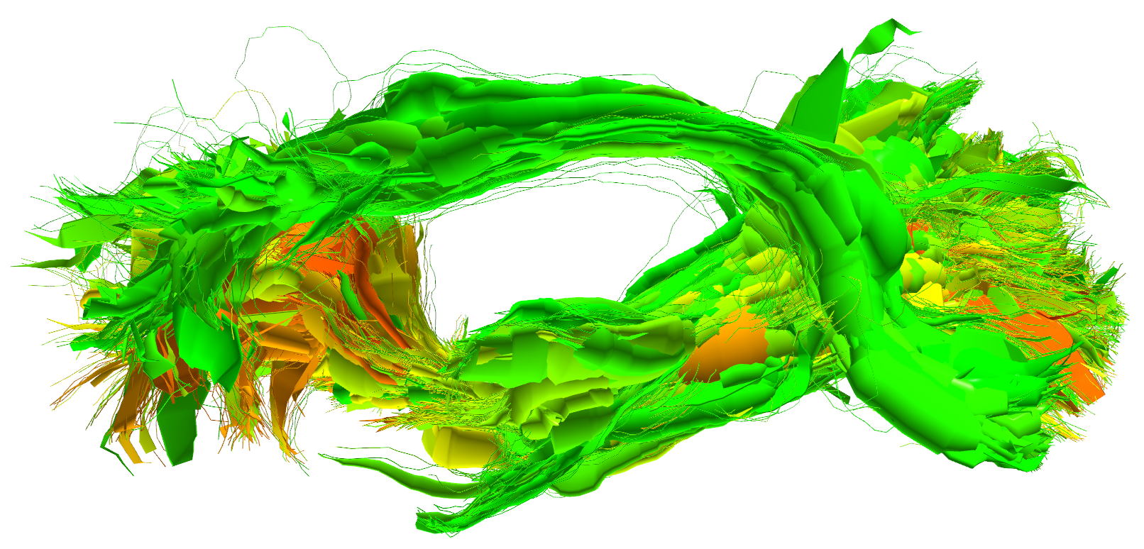
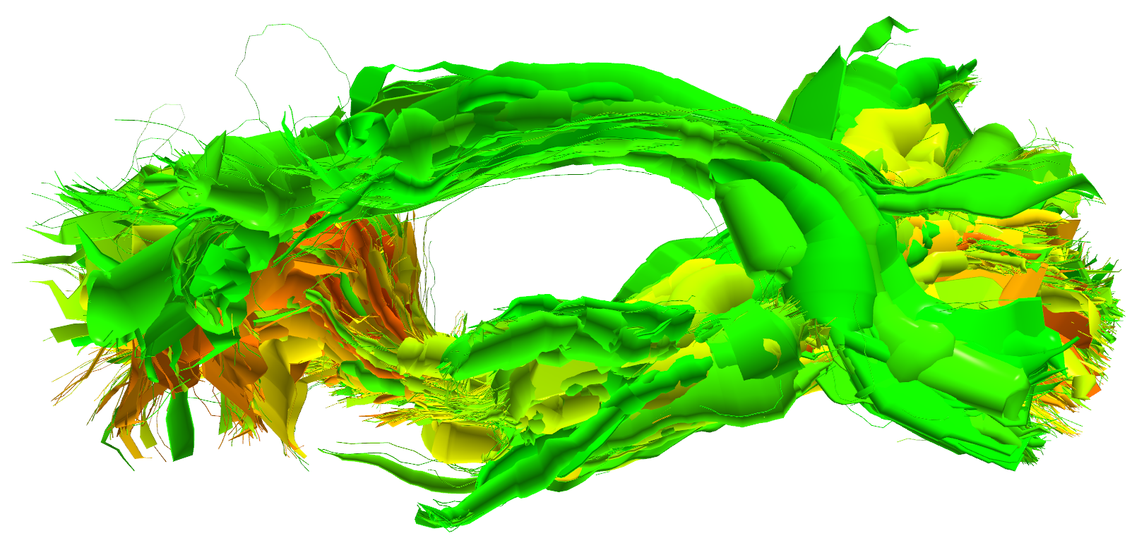
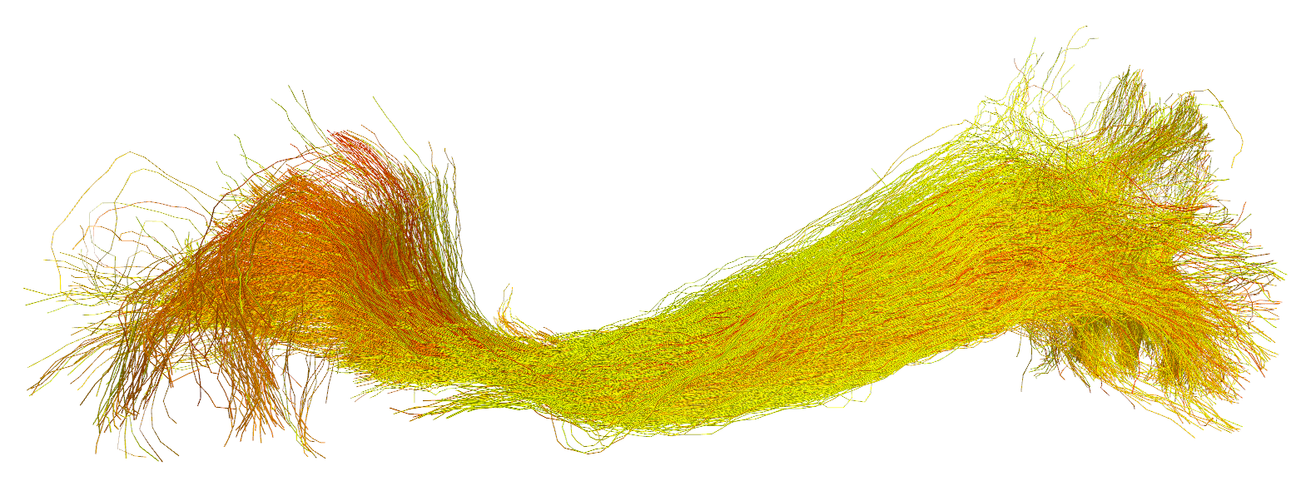
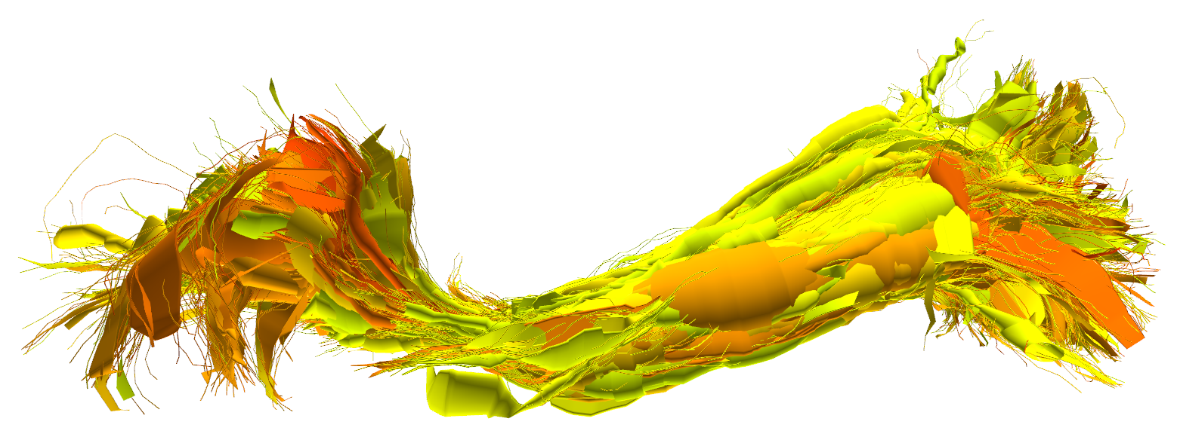
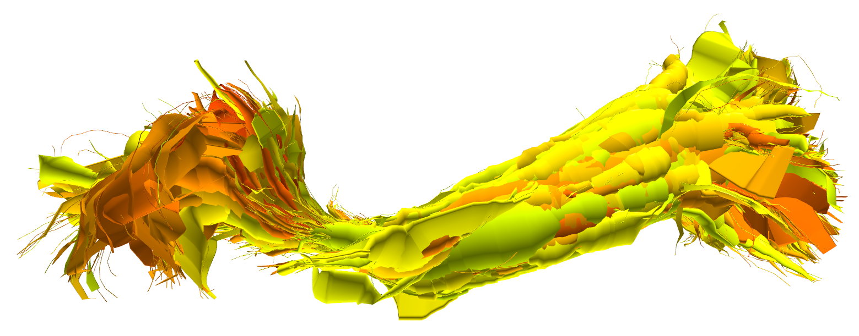
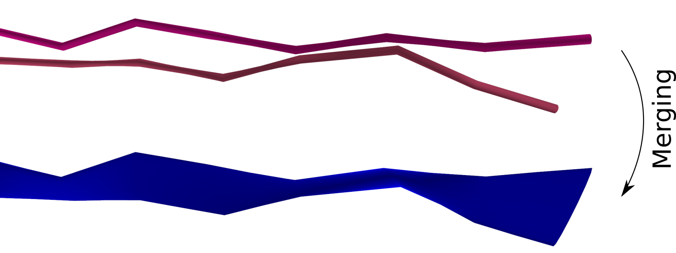
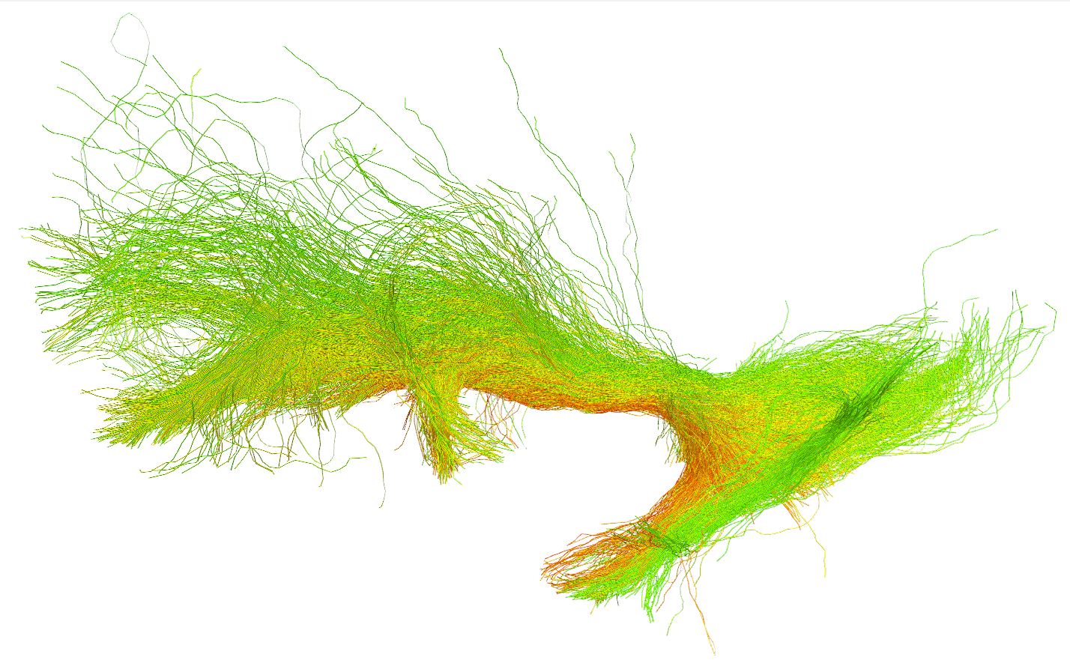
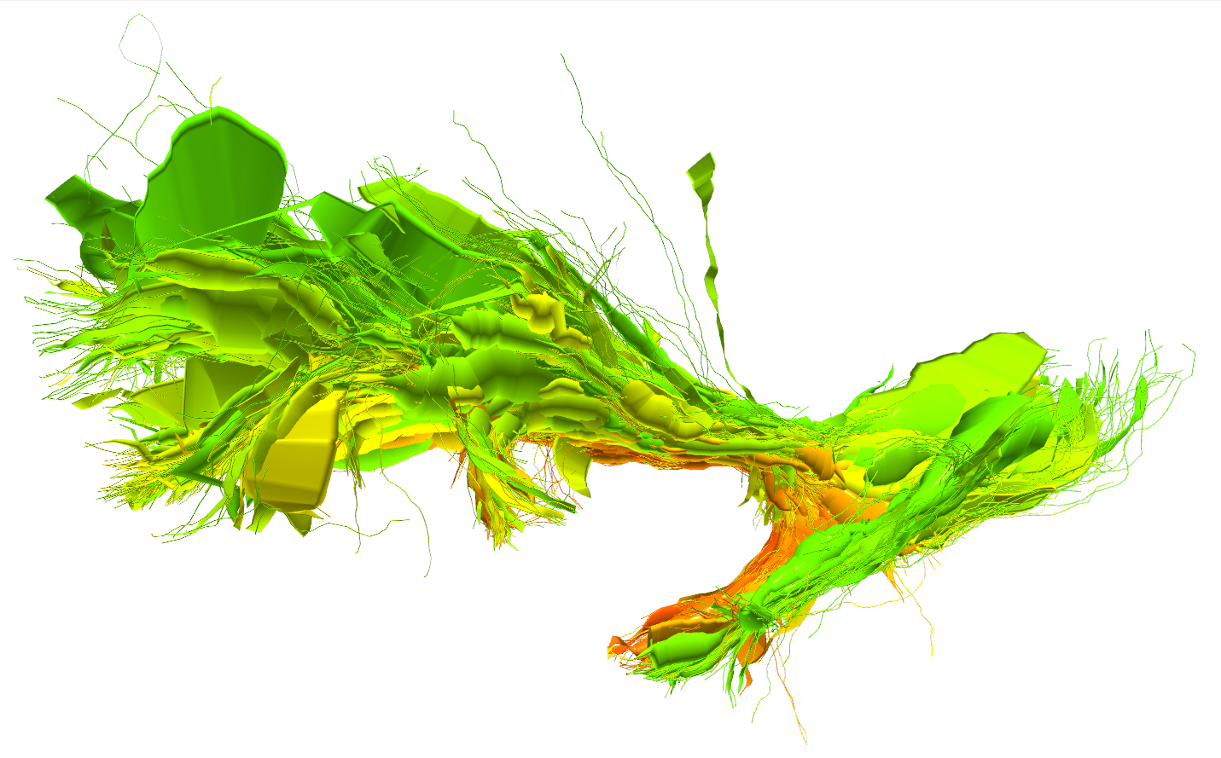
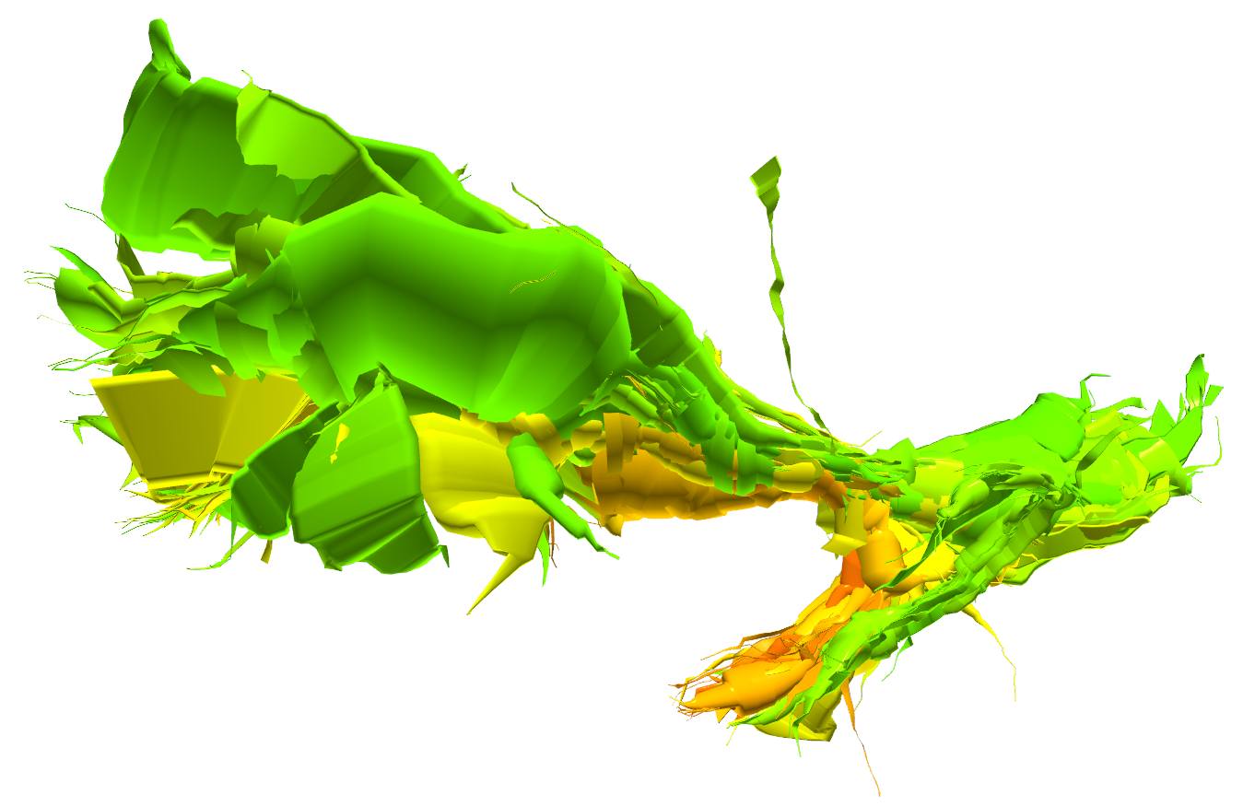
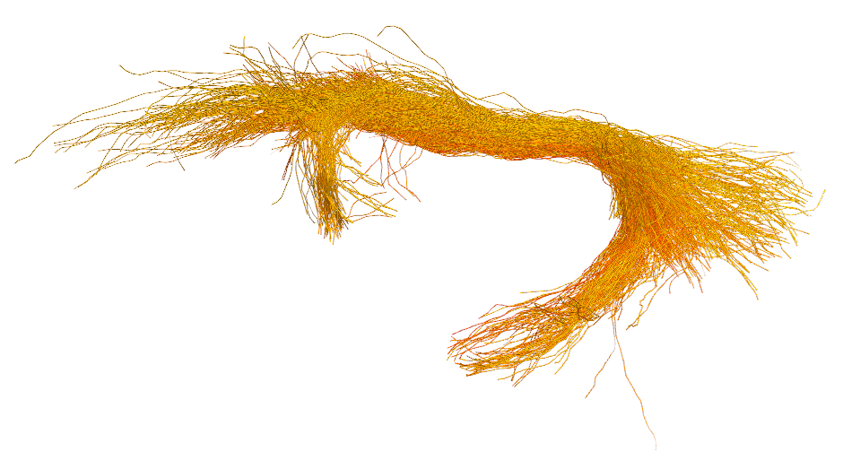
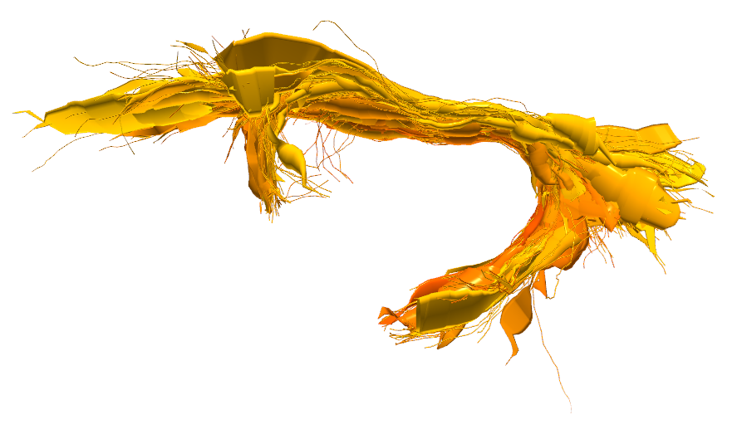
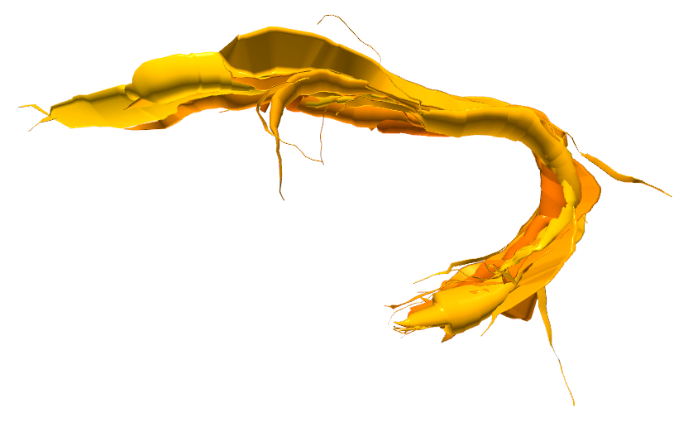






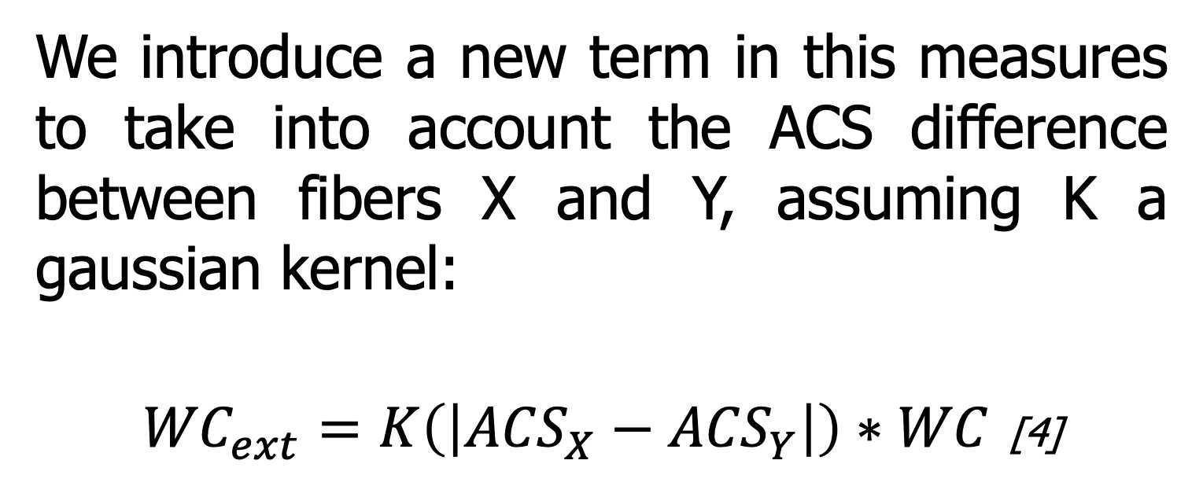
White Matter Multi-Resolution Segmentation Using Fuzzy Set Theory
*Alessandro Delmonte^{1,2}, *Corentin Mercier^{1,3}, Johan Pallud⁴, Isabelle Bloch^{1,2}, Pietro Gori¹
¹LTCI, Télécom ParisTech, Paris-Saclay University, Paris, France
²IMAG2 Laboratory, Imagine Institute, Paris, France
³LIX, Ecole Polytechnique, Palaiseau, France
⁴Neurosurgery Department, Sainte-Anne Hospital, Paris, France
INTRODUCTION / OBJECTIVE
* equally contributed to this work
We propose a method for white matter segmentation exploiting spatial relations between brain regions. We model the relations inherent incertitude relying on the spatial fuzzy set theory [1,2]. We complement this approach introducing an interactive visualization and segmentation technique for the bundle of interest based on a multi-resolution brain fiber representation [3].
SPATIAL RELATIONS MODELING
Clinicians often describe white matter fiber tracts based on their spatial properties relatively to known brain references. These descriptions are intrinsically vague, thus the need for an appropriate modelling framework. We apply spatial fuzzy set theory to represent the fibers degree of uncertainty to spatial, connectivity and trajectory properties (e.g. anterior of).
ACS 1
ACS 2
ACS 3
IFOF
For each tract we assign an anatomical coherence score (ACS) combining, with the fuzzy t-norm and t-conorm operators, the final satisfaction degree to the provided information. Users are able to interactively select the bundles that mostly fit their need with an ACS thresholding operation.
UF
0
ACS
1
Fig. 1: Thresholding IFOF and UF
MULTI-RESOLUTION REPRESENTATION
In order to ease understanding of the segmentation and give interactivity, we create a multi-resolution representation of the tractogram using [3]. This is performed by progressively merging fibers together according to their similarity measure.
FIBERS
Original Bundle
CYLINDERS
Medium Resolution
CYLINDERS
Low Resolution
0.8
ACS 1
We introduce a new term in this measures to take into account the ACS difference between fibers X and Y, assuming K a gaussian kernel:
${WC}_{ext}=K\left(\left|{ACS}_{X}−{ACS}_{Y}\right|\right)∗WC$ [4]
IFOF
ACS 2
0
ACS 1
1
UF
ACS 2
Doing so, we make it feasible to navigate between thresholds in an interactive way, using the simplified geometry of the multi-resolution representation.
Fig. 2: Multi-resolution visualization of fiber bundles
0
RESULTS
IEEE International Symposium on Biomedical Imaging – 2019 – Venice (IT)
We validated our results on 5 unrelated healthy adults subjects from the HCP dataset.
Compared to WMQL [4] and manual segmentation, our technique presents less scattered fibers (dispersion), especially in the arc connecting the temporal and frontal lobe, as shown in the dispersion colormap of figure 3.
The interactive analysis allowed neurosurgeons to better identify ACS thresholds producing the results that best fit the clinical reality.
ACS thresholds were found to be reproducible among our different testing.
FUTURE WORKS
We plan to extend the proposed technique to other tracts and use it in statistical analyses.
References
Fig. 3: Tracts dispersion map
[1] I. Bloch, “Fuzzy spatial relationships for image processing and interpretation: a review”, Image and Vision Computing, vol. 23, no. 2, pp. 89–110, 2005.
[2] A. Delmonte et al., “Segmentation of White Matter Tractograms Using Fuzzy Spatial Relations”, in Organization for Human Brain Mapping (OHBM), Singapore, 2018.
[3] C. Mercier et al., “Progressive and Efficient Multi-Resolution Representations for Brain Tractograms”, in EG VCBM, 2018.
[4] P. Gori et al., “Parsimonious Approximation of Streamline Trajectories in White Matter Fiber Bundles,” IEEE TMI, vol. 35, no. 12, pp. 2609–2619, 2016.
[5] D. Wassermann et al., “The white matter query language: a novel approach for describing human white matter anatomy,” Brain Structure and Function, vol. 221, no. 9, pp. 4705–4721, 2016.
Poster n°582
Contacts:
alessandro.delmonte@institutimagine.org
corentin.mercier@telecom-paristech.fr
https://github.com/CorentinMercier/FBTS

